Slide 1
AceEngineer
Architecture Development
02 January 2019

Slide 2
Introduction
The object of establishing an architecture is to help standardize processes and thus scale for services
Our objectives is to have a consistent process for the key data objects
Programs or applications
Development
Repository
Deployment
Data storage
Databases for Dev, staging and production
Website
Development
Hosting
Regular files (Word, ppt, client data etc.)

Slide 3
Work Plan

Slide 4
Work Plan | Overview
Phase 1
Code standardization
Utilize Git, manuals up to date, folder structure standardlized, etc.
Existing websites should be online
Phase 2
Updated AceEngineer website (without database dependency) is be online
New Applications with no/little database dependency should be included

Slide 5
Programs or Applications

Slide 6
Programs | Overview
Development will be done by multiple people. Therefore, to help team work, git is a great tool
Repository that supports git will be very beneficial for efficient teamwork

Slide 7
Code Repository
A comparison of available services is given below
 | AWS Codecommit | Azure Devops | GCP | BitBucket
No.of users | 5 | 5 | 5 | 5
No. of git requests | 10,000 | unlimited | ?
Per month | 50GB-month | unlimited | 50GB-month
Pipelines | 1 | 10?
Boards | n/a | Kanban | n/a
Ranking
Azure seems to be the clear winner

Slide 8
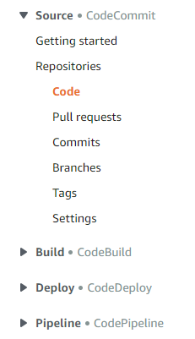
Code | Typical Life Cycle

Slide 9
Code Repository | Way Forward
Started with Azure
https://dev.azure.com/vamseeachanta/_git/aceengineer
Azure has Kanban boards which can be efficiently used as well for project management in conjunction with the codes
portal.azure.com
I sent invitations to both of you (Ganga and SivaRaju)
Code back
Put all the codes in a single folder and host it in repository
All code actions will be on Azure Devops board

Slide 10
Code Repository | References
AWS: CodeCommit
Google: BigQuery?
Azure: DevOps

Slide 11
Database Storage

Slide 12
Introduction
Start in cloud and then shift to own servers?
A CI/CD strategy will help deploy the applications in a continual manner with minimal or no interruption
Data insert into databases will be done by the python program
??

Slide 13
Database – Development & Stage
Start in cloud and then shift to own servers?
Start on own servers then shift to cloud?
Some good database technologies are listed below. We need to choose 1 technology for Development and 1 technology for staging purposes.
MySQL (Development)
PostGreSQL (Staging).
MongoDB
??

Slide 14
Database - Production
A comparison of available services is given below.
 | AWS DynamoDB | Azure | GCP BigQuery | Heroku
Storage (GB) | 25 | 0? | 10 | 0.008
Writes (MM/month) | 100
Reads (MM/month) | 100 |  | 1TB
Python Interface | Good (boto3) |  | Average | Good
Ranking
AWS DynamoDB is chosen for economics and python interface?

Slide 15
Database | Conclusions
The three databases to be used for our work are summarized in table.
Key items are noted below:
Note that SQLAlchemy can only be used with SQL databases where support exists
3 database technologies are chosen to help retain flexibility and portability as applications and usability grows.
 | Development | Staging | Production
Server | local | local | AWS Cloud
Technology | mysql | PostgreSQL | DynamoDB
SQL/NoSQL | SQL | SQL | NoSQL
Python Interface | SQLAlchemy | SQLAlchemy | Boto3

Slide 16
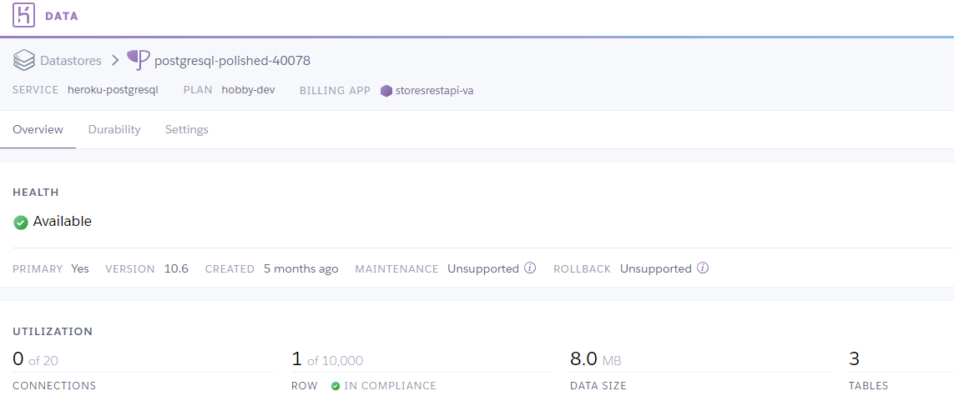
Database | References
AWS: DynamoDB
https://github.com/boto/boto3
https://boto3.amazonaws.com/v1/documentation/api/latest/index.html
Google: BigQuery
https://cloud.google.com/bigquery/docs/quickstarts/quickstart-client-libraries
https://www.blendo.co/blog/access-data-google-bigquery-python-r/
https://pypi.org/project/google-cloud-bigquery/
https://googleapis.github.io/google-cloud-python/latest/bigquery/index.html
Heroku : PosgreSQL

Slide 17
CI/CD Strategy

Slide 18
Introduction
A CI/CD strategy will help deploy the applications in a continual manner with minimal or no interruption
??

Slide 19
Folder Structure

Slide 20
Folder Structure
All applications will be driven from a main file.
The root folder is below
~\aceengineer\
In this folder, the main running files will reside
This folder will also contain “Common” and “dataprovision” directories.
All common files will go into common folder
All dataprovision files will go into subfolder of dataProvision directory.
The subfolder will reflect the name of the main program.
As the main files grow in number,
they can be grouped into categories or classes and the number can be restrained/managed in a planned manner.
This will also help keep the number of manuals to the same category.

Slide 21
Website or Apps

Slide 22
Apps - Production
A comparison of available services is given below
 | AWS | Azure App Service | GCP | Heroku
No. of. apps | ? | 10
Ranking
Azure ranking high?

Slide 23
Recommended Technologies
Applications
Python Code
Website Building
Flask
GUI (or front design)
Angular JS
Database
Development and Stage on local computer
Technology: MongoDB or MySQL?

Slide 24
Way Forward
Host AceEngineer and HairByLiz Websites
Docker files -> azuredevops
F2-Micro -> get container running
Run powershell to start the container
check websites are working.
Change ip address in domain owner (go daddy) ->
check websites are working.

Slide 25
References
https://www.heroku.com/pricing#dyno-comparison
https://blog.patricktriest.com/host-webapps-free/
Hosting on S3
https://docs.aws.amazon.com/AmazonS3/latest/dev/WebsiteHosting.html

Slide 26
Regular File Storage

Slide 27
Overview
Completed project.
Amazon (S3 Storage)
To use long term.
Eg: KM-Riser Analysis Backup

Slide 28
Client Reports

Slide 29
Overview
Utilize python-latex for text
https://pypi.org/project/PyLaTeX/0.6.1/
Utilize python for interactive charts
https://plot.ly/python/pdf-reports/

Slide 30
Working in GCP
Utilize Google Cloud SDK
Google cloud SDK commands:
gcloud compute scp hairbyliz aceengineerdata:~/

Slide 31
References
https://aws.amazon.com/free/?awsf.Free%20Tier%20Types=categories%23alwaysfree
https://cloud.google.com/free/docs/gcp-free-tier
https://azure.microsoft.com/en-us/free/free-account-faq/

Slide 32
THANK YOU
For the opportunity to serve!

Slide 33
Document Revision History
01 | New document | 16 June 2016 |  | VA
Rev | Description | Date |  | Author | Checked | Approved
Document No: |  |  | Client Ref:
0132-PRE-0001-01 |  |  | n/a

Slide 34
Website
Website Files??
Website Files
Local Computer
Development
Storage
Production
Online
(Amazon Litesale,
Digital Ocean,
Azure)
AceEngineer US Server

Slide 35
Dynamic Websites with Database Back-ends

Slide 36
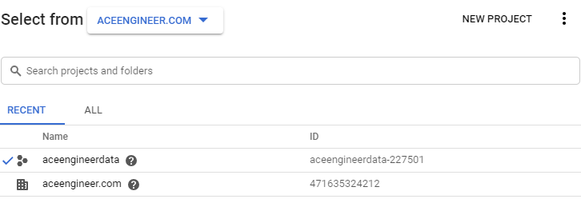
Overview
Can use compute resources from a cloud service
F1-micro (in GCP) is free every month
10GB space
Linux VM (Debian OS)
Aceengineerdata resource

Slide 37
GCP | F1 Micro
Aceengineerdata resource
https://console.cloud.google.com/compute/instances?folder=&organizationId=471635324212&project=aceengineerdata-227501
VM Instances

Slide 38
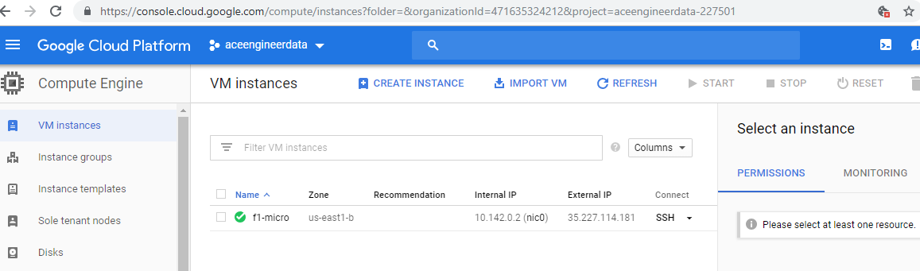
GCP | F1 Micro
https://console.cloud.google.com/compute/instances?folder=&organizationId=471635324212&project=aceengineerdata-227501
VM Instances

Slide 39
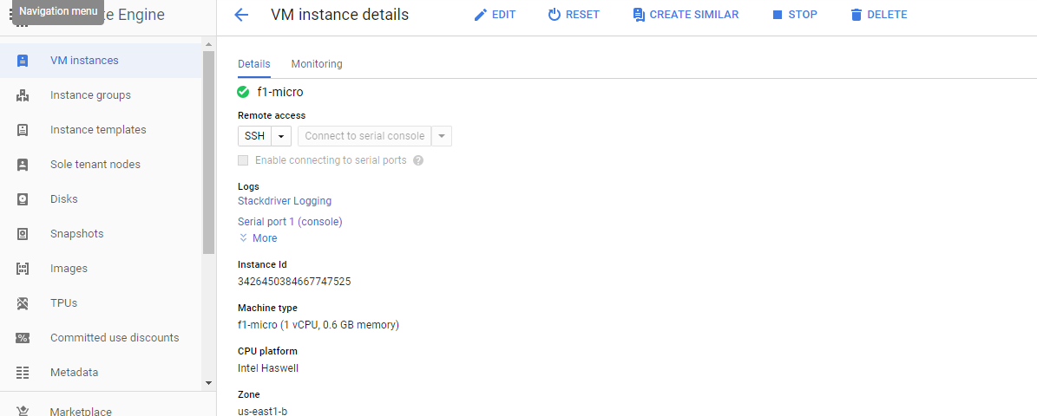
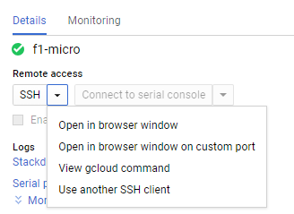
GCP | F1 Micro
Accessing VMs
Open in browser and program

